Slide 1
PRINCIPLES OF PROGRAMMING
An overview of programming languages

Slide 2
What are Program and programming language?
Program : Is a collection of instructions that can be executed by a computer to perform a specific task.
  Examples: Microsoft (MS) Excel, MS PowerPoint, MS Word, Internet Explorer, Google Chrome, Opera, …
Programming Language : A formal language that is intended for the creation of computer programs.
  Computer programs are written/created by using programming languages.
  Examples:Python, Ruby, Java, JavaScript, C, C++, and C#

Slide 3
Why study programming languages?
Programming languages are important for students in most science disciplines.
  Reason:
    They are the primary tools of the central activity of any science.
      A programming language lets you express computational tasks in certain ways.

Slide 4
Why study programming languages? (cont.)
To improve your ability to develop effective algorithms and to improve your use of your existing programming language.
  Can help you improve algorithm efficiency.
    Save resources like time, computing power, …
To increase your vocabulary of useful programming constructs.
  Learn more programming concepts.
To allow a better choice of programming languages.
  Be able to choose an appropriate programming language for solving a specific case/problem.
To make it easier to learn a new language.
  The programming languages have some sort of similarities as you will see with time.

Slide 5
The Evolution of Programming Languages
To build programs, people use programming languages that are similar to human language.
      The results (the programs) are translated into machine code (0s and 1s) which computers understand.
  Programming languages fall into three broad categories:
Machine languages
Assembly languages
Higher-level languages

Slide 6
The Evolution of Programming Languages -
Machine Languages
Machine languages
      They are also known as the first-generation languages.
      Description:
        They are the most basic type of computer languages, consisting of strings of numbers that the computer's hardware can use.
          They consist of binary numbers – a series of zeros and ones (0s and 1s).

Slide 7
The Evolution of Programming Languages -
Machine Languages
Machine languages
      Different types of computer hardware use different machine code.
        For example: IBM computers use different machine language from Apple computers.
        That is machine language is machine dependent (different computer hardware manufacturers have different machine code)
          Examples of computer manufacturers:
            hp, dell, acers, apple, …
      NOTE:
        They are fastest to execute because it is already in the language that the computer can understand.
        But they are time consuming/tedious to use.
          Programming becomes more difficult as the complexity of the program increases.

Slide 8
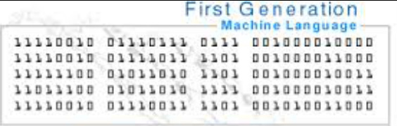
The Evolution of Programming Languages -
Machine Languages
Machine languages

Slide 9
The Evolution of Programming Languages - Assembly Languages
Assembly languages.
      They are also known as second-generation languages.
      Assembly language is a language that uses words in place of the binary numbers to instruct a computer to perform a specific task.
        A computer can not directly understand assembly language.
          Assembly language programs are translated into machine language/code by a program called an assembler.

Slide 10
The Evolution of Programming Languages - Assembly Languages
Assembly languages.
        Assembly language is somewhat easier to work with than machine languages.
          As it uses shortened words in place of the numbers (the 0s and 1s)
          As machine language, assembly language is also machine dependant.
        To create programs in assembly language, developers use some shortened English-like words to represent strings of numbers.
          The program is then translated into machine code, using a translator called an assembler.

Slide 11
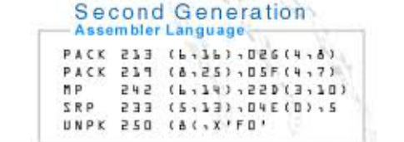
The Evolution of Programming Languages - Assembly Languages
Assembly languages.

Slide 12
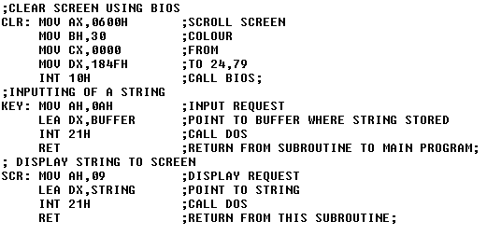
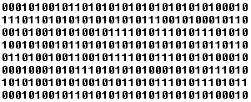
Assembly
code
Assembler
Object code

Slide 13
The Evolution of Programming Languages -
Higher-Level Languages
Higher-level languages are more powerful than assembly language and allow the programmer to work in a more English-like environment.
    They use English words.
    They are not limited by the computer.
      The same program can be executed on different computers.
        They are machine independent.
    Higher-level programming languages are divided into three "generations," each more powerful than the last:
        Third-generation languages
        Fourth-generation languages
        Fifth-generation languages

Slide 14
Higher-Level Languages -
Third-Generation Languages
Third-generation languages (3GLs) are the first to use true English-like words, making them easier to use than previous languages.
3GLs are portable, meaning the object code created for one type of system can be translated for use on a different type of system.
The following languages are 3GLs:
      FORTAN
      C
      COBOL
      C++
      BASIC
      Java
      Pascal
      ActiveX

Slide 15
Higher-Level Languages -
Fourth-Generation Languages
Fourth-generation languages (4GLs) are even easier to use than 3GLs.
      4GLs may use a text-based environment (like a 3GL) or may allow the programmer to work in a visual environment, using graphical tools.
        Improved version of 3GLs in text-based environments.
        Can also allow the programmer to graphically create programs.
          Examples is the use of drag and drop to create a computer program
      The following languages are 4GLs:
            Visual Basic (VB)
            VisualAge
            Authoring environments

Slide 16
Higher-Level Languages -
Fifth-Generation Languages
Fifth-generation languages (5GLs):
      They are an issue of debate in the programming community.
        Some programmers cannot agree that they even exist.
      These high-level languages would use artificial intelligence to create software.
        This will make 5GLs extremely difficult to use in developing computer programs.

Slide 17
Higher-Level Languages
  Programs written in a high-level language need to be translated into machine language/code before they can be executed by a computer.
    Some programming languages use a compiler to perform this translation and others use an interpreter.

Slide 18
Assignment
Identify the three main categories of programming languages.
Describe the five generations of programming languages.
Name at least five major programming languages.

Slide 19
END

